Slide 1
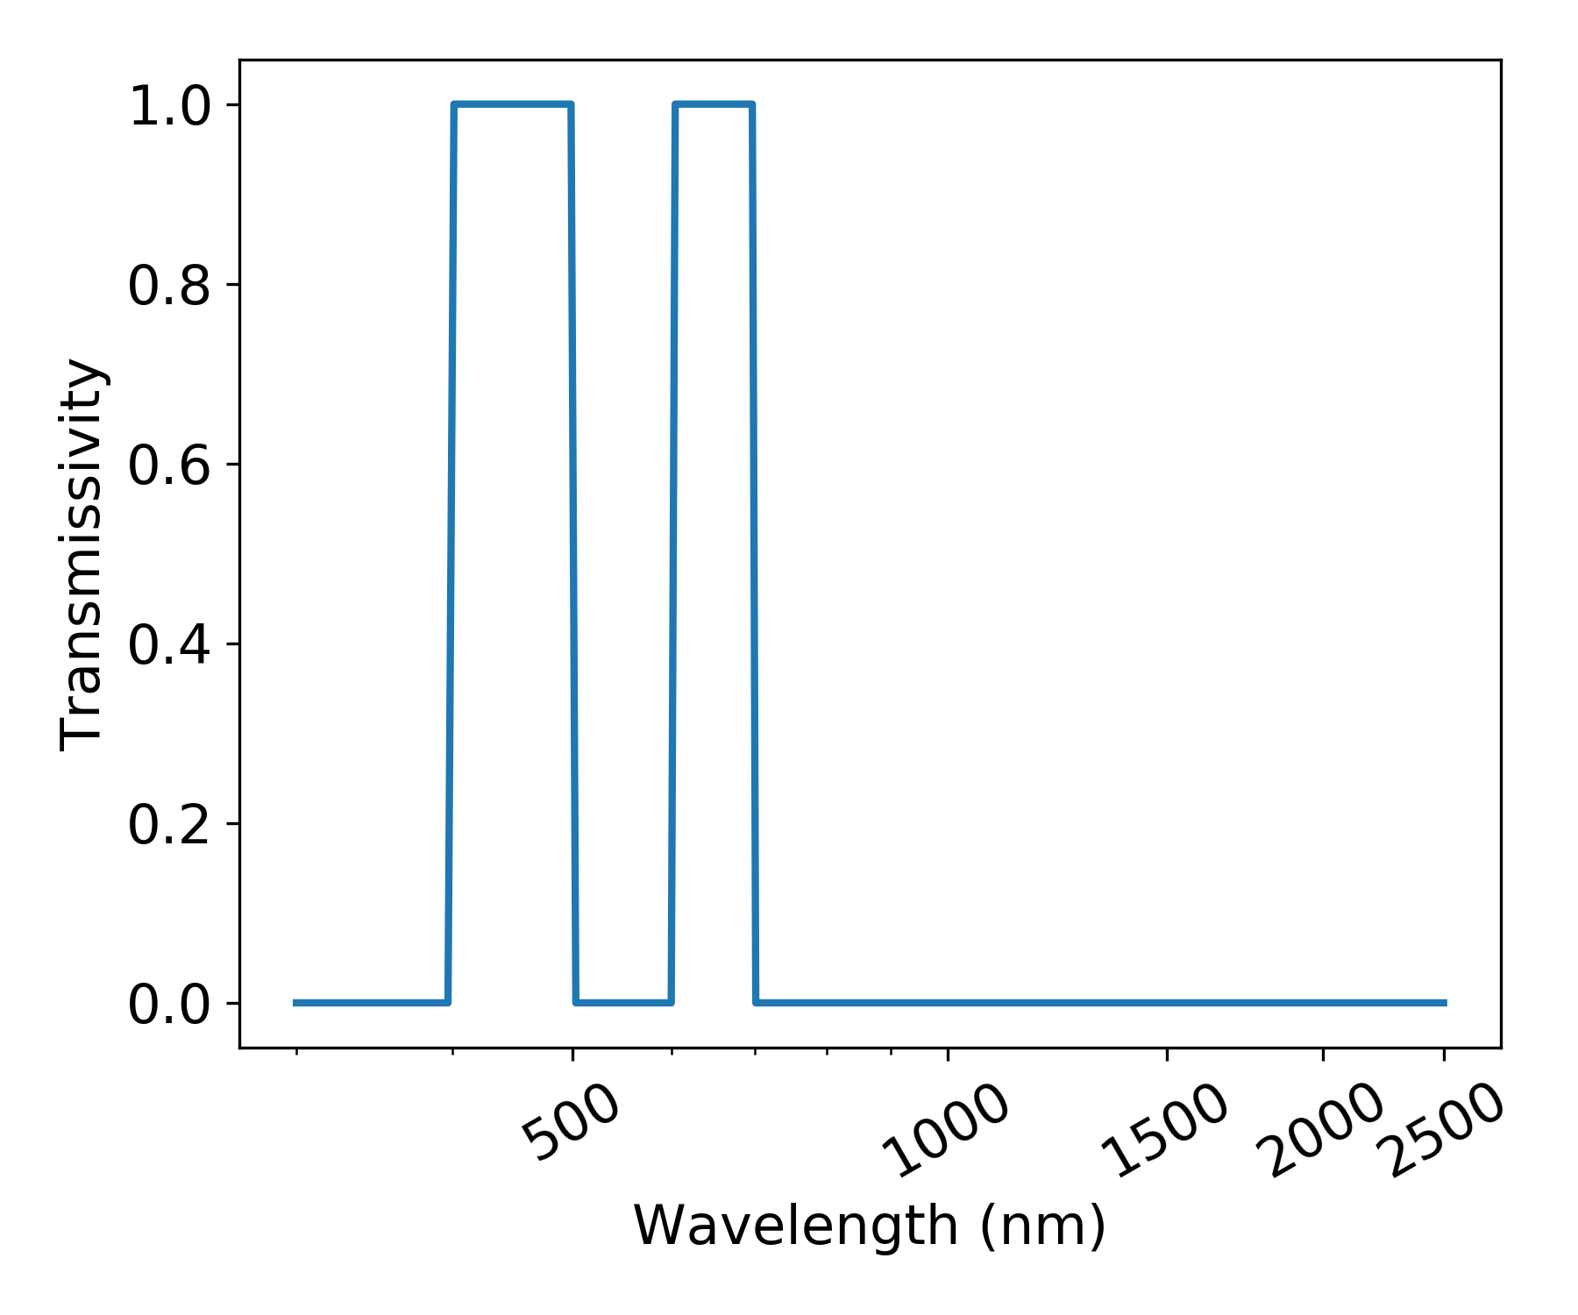
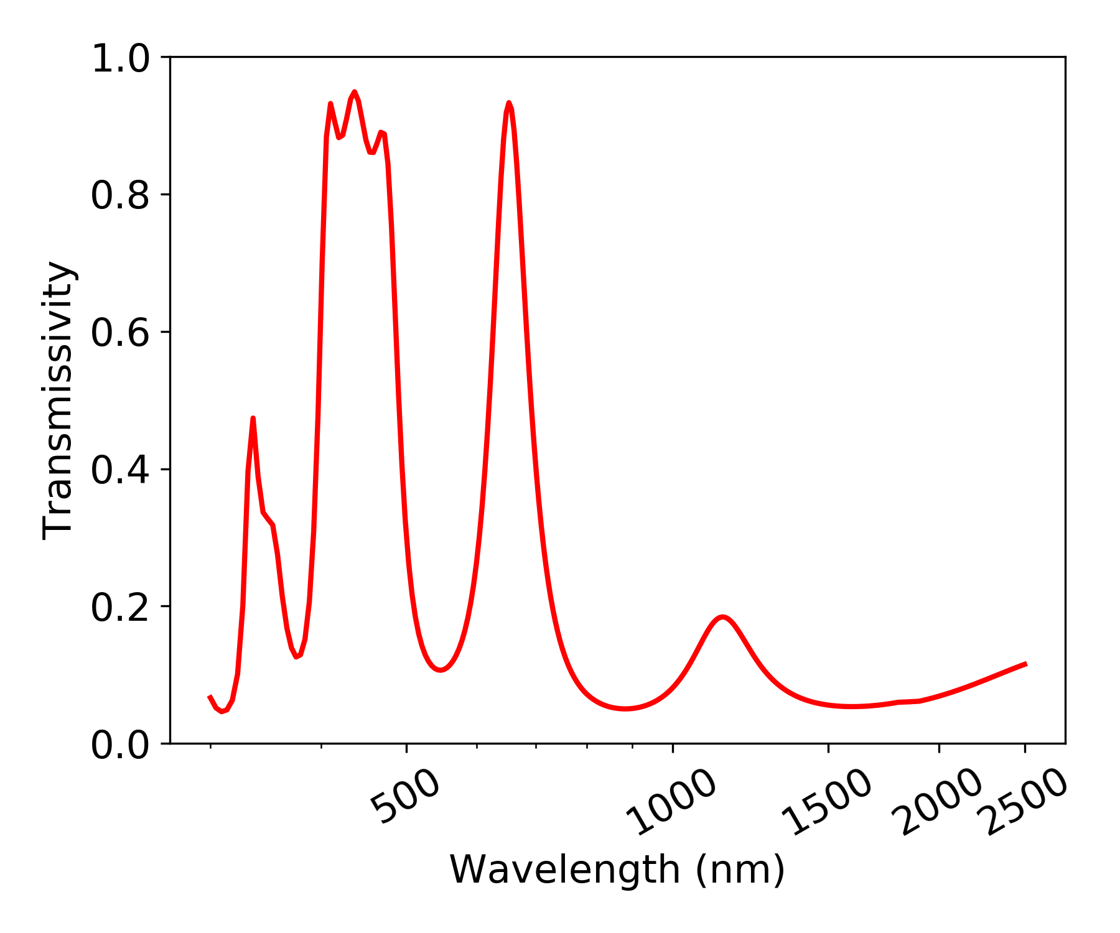
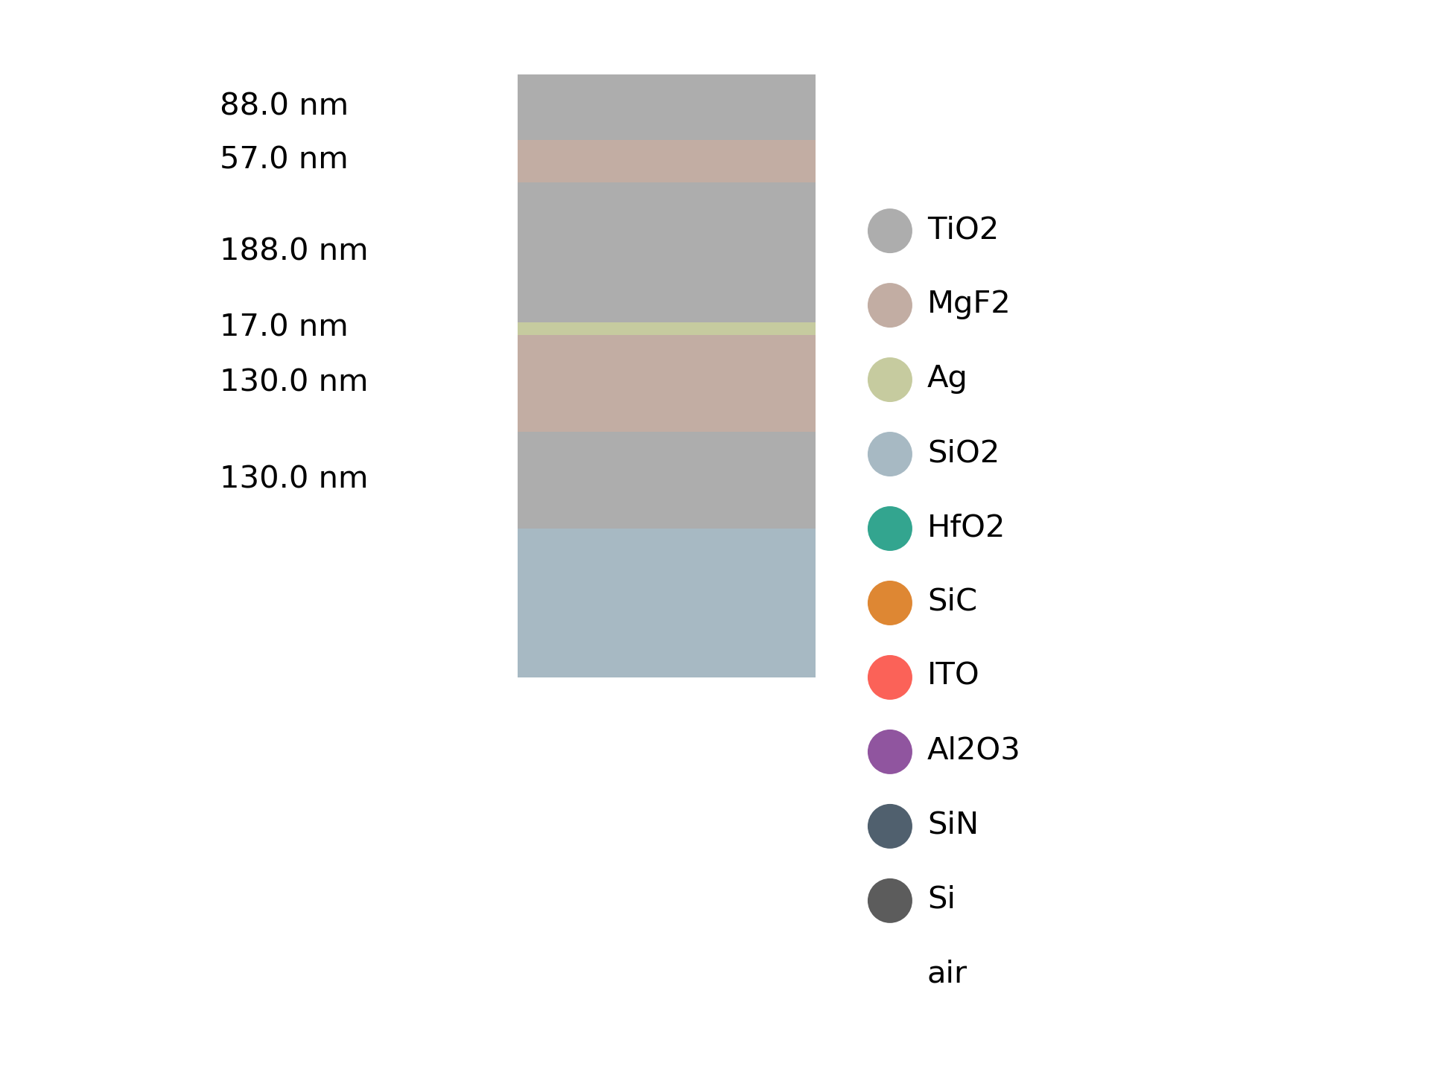
Schematic of the design process
Spectrum error
Generation 1
Genetic algorithm
Reproduction
Generation 2
Target spectrum
…
Scalability, fabrication
Mutation
Angle dependence
Generation n
Filtering
Initial design
Material
selection
Optimized spectrum
hidden
Neural network
target
spectrum
design
TMM
optimized spectrum

